Slide 1
MATLAB
Class 8: Regressions and SVM

Slide 2
What is one of the ultimate goals of a model?

Slide 3

PREDICT

Slide 4
Computational models make predictions based on hypotheses. They predict the state of an outcome variable (y) given new information x or at a new time point (xt)

Slide 5
How do computers learn?
In machine learning and computational modelling, the way you teach your algorithm to predict can take one of two forms: supervised learning and Unsupervised learning

Slide 6
How do computers learn?
supervised learning takes place when algorithms are fed examples of data to learn from like in regressions and SVM
Much like when you were a little kid, you were taught the alphabet with examples of words that start with each letter

Slide 7
How do computers learn?
Unsupervised learning takes place when algorithms learn without examples, but through trial and error without the need of labels
Much like when you learned how to ride a bike
Examples include k-means (see class on clustering)

Slide 8
What is a regression ?

Slide 9
To put it simply a regression is a set of statistical tools used to describe and quantify the relationship between dependent and independent variables

Slide 10
Dependent variables (y) are the outcomes we wish to predict based on independent variables

Slide 11
Independent variables (x) are the covariates/ predictors / features we think change the value of the outcome variable in a quantifiable way

Slide 12
Types of regression models
Linear Model:
Used when the outcome variables are continuous
Logistic Model:
Used when the outcome variables are binary
Hierarchical Model:
Used when your data has a defined structure (i.e., variables are nested)
*** not mutually exclusive

Slide 13
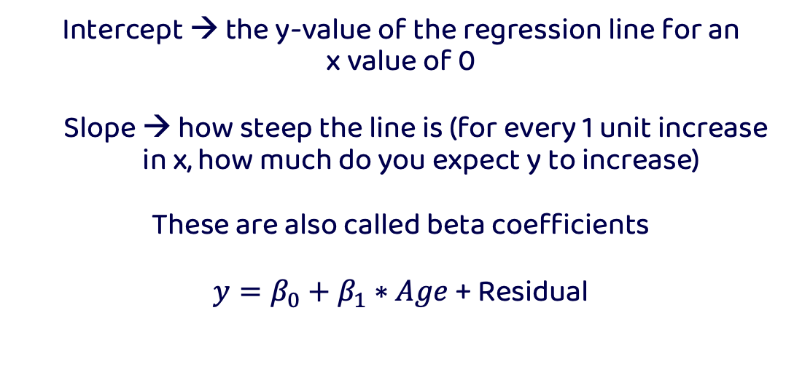
Linear regression models
Intercept → the y-value of the regression line for an
x value of 0
Slope → how steep the line is (for every 1 unit increase in x, how much do you expect y to increase)
These are also called beta coefficients
$y=β_{0}+β_{1}∗Age$ + Residual

Slide 14
Linear Regression Models

Slide 15
Linear Regression Models
Coding of your ordinal predictors is important for the interpretation of your betas/ coefficients:
Linear coding: 1 2 3 assumes that there is a linear relationship between the orders (i.e., x=1 is half of x=2, etc.)

Slide 16
Linear Regression Models
Coding of your categorial predictors is very important for the interpretation of your betas:
Dummy coding
Effect Coding

Slide 17
Dummy Coding
Attention | Difficulty | Dummy Attention | Dummy Difficulty
High | easy | 1 | 0
Low | easy | 0 | 0
High | easy | 1 | 0
High | hard | 0 | 1
Low | hard | 1 | 1
High | hard | 0 | 1
Attention (X1) | Difficulty (X2) | Var Attention | Var Difficulty
High | easy | 1 | 0
Low | easy | 0 | 0
High | easy | 1 | 0
High | hard | 0 | 1
Low | hard | 1 | 1
High | hard | 0 | 1
Let’s say we have two categorical variables:
Attention (high vs low)
Difficulty (easy vs hard)
Dummy code them as 0 and 1

Slide 18
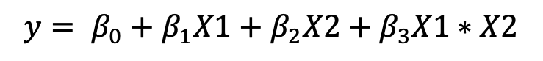
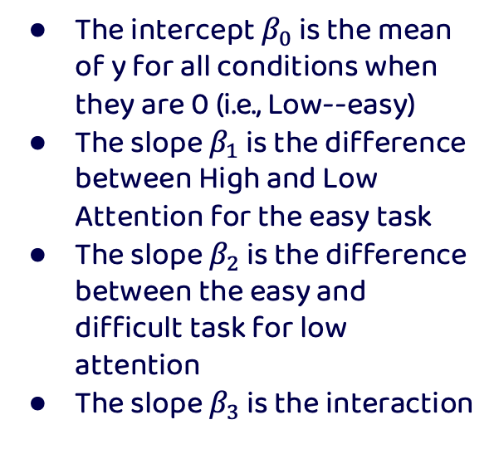
Dummy Coding
The intercept $β_{0}$ is the mean of y for all conditions when they are 0 (i.e., Low--easy)
The slope $β_{1}$ is the difference between High and Low Attention for the easy task
The slope $β_{2}$ is the difference between the easy and difficult task for low attention
The slope $β_{3}$ is the interaction
Attention (X1) | Difficulty (X2) | Var Attention | Var Difficulty
High | easy | 1 | 0
Low | easy | 0 | 0
High | easy | 1 | 0
High | hard | 1 | 1
Low | hard | 0 | 1
High | hard | 1 | 1
$$y= β_{0}+β_{1}X1+β_{2}X2+β_{3}X1∗X2$$

Slide 19




Dummy Coding
Our regression model: $y= β_{0}+β_{1}X1+β_{2}X2+β_{3}X1∗X2$
$$y= β_{0}+β_{1}0+β_{2}0+β_{3}0∗0$$
$$y= β_{0}$$
$$y= β_{0}+β_{1}1+β_{2}0+β_{3}1∗0$$
$y= β_{0}$ $+β_{1}$
$$y= β_{0}+β_{1}0+β_{2}1+β_{3}0∗1$$
$y= β_{0}$ $+β_{2}$
$$y= β_{0}+β_{1}1+β_{2}1+β_{3}1∗1$$
$y= β_{0}$ $+β_{1}+β_{2}+β_{3}$

Slide 20


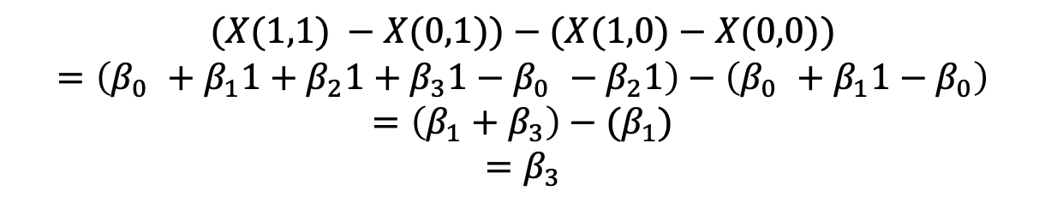
Dummy Coding
Our regression model: $y= β_{0}+β_{1}X1+β_{2}X2+β_{3}X1∗X2$
$X\left(1,0\right)− X\left(0,0\right)= β_{0}+β_{1}1−$ $β_{0}$
$$X\left(1,0\right)− X\left(0,0\right) = β_{1}$$
$X\left(0,1\right)− X\left(0,0\right)= β_{0}+β_{2}1−$ $β_{0}$
$$X\left(0,1\right)− X\left(0,0\right) = β_{2}$$
$$(X(1,1) −X(0,1))−(X(1,0)−X(0,0))$$
$$=\left(β_{0} +β_{1}1+β_{2}1+β_{3}1−β_{0} −β_{2}1\right)−\left(β_{0} +β_{1}1−β_{0}\right)$$
$$=\left(β_{1}+β_{3}\right)−(β_{1})$$
$$=β_{3}$$

Slide 21
Dummy Coding
Our regression model: $y= β_{0}+β_{1}X1+β_{2}X2+β_{3}X1∗X2$
$X\left(1,0\right)− X\left(0,0\right)= β_{0}+β_{1}1−$ $β_{0}$
$$X\left(1,0\right)− X\left(0,0\right) = β_{1}$$
$X\left(0,1\right)− X\left(0,0\right)= β_{0}+β_{2}1−$ $β_{0}$
$$X\left(0,1\right)− X\left(0,0\right) = β_{2}$$
$$(X(1,1) −X(0,1))−(X(1,0)−X(0,0))$$
$$=\left(β_{0} +β_{1}1+β_{2}1+β_{3}1−β_{0} −β_{2}1\right)−\left(β_{0} +β_{1}1−β_{0}\right)$$
$$=\left(β_{1}+β_{3}\right)−(β_{1})$$
$$=β_{3}$$

Slide 22
Effect Coding
Attention | Difficulty | Dummy Attention | Dummy Difficulty
High | easy | 1 | 0
Low | easy | 0 | 0
High | easy | 1 | 0
High | hard | 0 | 1
Low | hard | 1 | 1
High | hard | 0 | 1
Attention (X1) | Difficulty (X2) | Var Attention | Var Difficulty
High | easy | 1 | -1
Low | easy | -1 | -1
High | easy | 1 | -1
High | hard | 1 | 1
Low | hard | -1 | 1
High | hard | 1 | 1
In effect coding all columns of variables sum to 0
To do this let’s try replacing the 0’s with -1

Slide 23
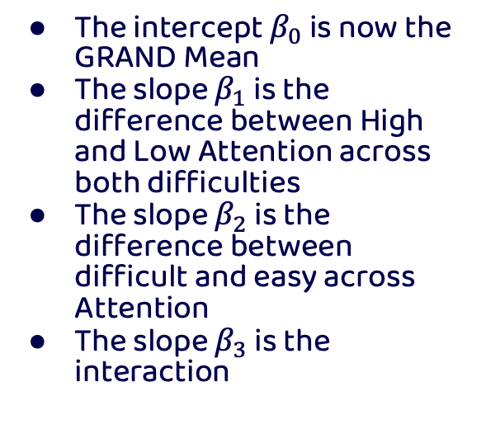
Effect Coding
The intercept $β_{0}$ is now the GRAND Mean
The slope $β_{1}$ is the difference between High and Low Attention across both difficulties
The slope $β_{2}$ is the difference between difficult and easy across Attention
The slope $β_{3}$ is the interaction
Attention | Difficulty | Dummy Attention | Dummy Difficulty
High | easy | 1 | 0
Low | easy | 0 | 0
High | easy | 1 | 0
High | hard | 0 | 1
Low | hard | 1 | 1
High | hard | 0 | 1
Attention (X1) | Difficulty (X2) | Var Attention | Var Difficulty
High | easy | 1 | -1
Low | easy | -1 | -1
High | easy | 1 | -1
High | hard | 1 | 1
Low | hard | -1 | 1
High | hard | 1 | 1
$$y= β_{0}+β_{1}X1+β_{2}X2+β_{3}X1∗X2$$

Slide 24




Effect Coding
Our regression model: $y= β_{0}+β_{1}X1+β_{2}X2+β_{3}X1∗X2$
$$y= β_{0}+β_{1}(−1)+β_{2}(−1)+β_{3}(−1)∗(−1)$$
$$y= β_{0}−β_{1}−β_{2}+β_{3}$$
$$y= β_{0}+β_{1}(1)+β_{2}(−1)+β_{3}(1)∗(−1)$$
$$y= β_{0}+β_{1}−β_{2}−β_{3}$$
$$y= β_{0}+β_{1}(−1)+β_{2}(1)+β_{3}(−1)∗(−1)$$
$$y= β_{0}−β_{1}+β_{2}−β_{3}$$
$$y= β_{0}+β_{1}(1)+β_{2}(1)+β_{3}(1)∗(1)$$
$$y= β_{0}+β_{1}+β_{2}+β_{3}$$

Slide 25
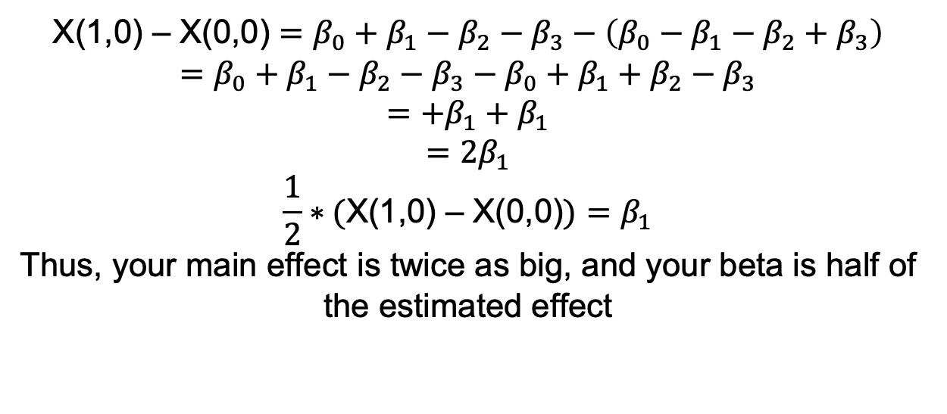
Effect Coding
Our regression model: $y= β_{0}+β_{1}X1+β_{2}X2+β_{3}X1∗X2$
X(1,0) – X(0,0) $=β_{0}+β_{1}−β_{2}−β_{3}−\left(β_{0}−β_{1}−β_{2}+β_{3}\right)$
$$=β_{0}+β_{1}−β_{2}−β_{3}−β_{0}+β_{1}+β_{2}−β_{3}$$
$$=+β_{1}+β_{1}$$
$$=2β_{1}$$
$$\frac{1}{2}∗(\text{X}\text{(1,0) – }\text{X}\text{(0,0)})=β_{1}$$
Thus, your main effect is twice as big, and your beta is half of the estimated effect

Slide 26
Effect Coding
Attention | Difficulty | Dummy Attention | Dummy Difficulty
High | easy | 1 | 0
Low | easy | 0 | 0
High | easy | 1 | 0
High | hard | 0 | 1
Low | hard | 1 | 1
High | hard | 0 | 1
Attention (X1) | Difficulty (X2) | Var Attention | Var Difficulty
High | easy | 0.5 | -0.5
Low | easy | -0.5 | -0.5
High | easy | 0.5 | -0.5
High | hard | 0.5 | 0.5
Low | hard | -0.5 | 0.5
High | hard | 0.5 | 0.5
What about replacing 0’s with -0.5 and 1’s with 0.5

Slide 27
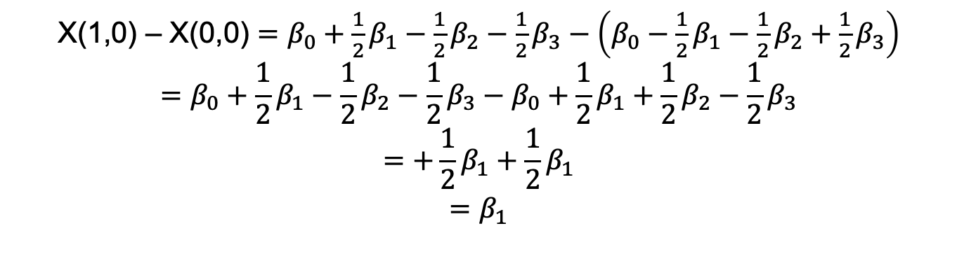
Effect Coding
Our regression model: $y= β_{0}+β_{1}X1+β_{2}X2+β_{3}X1∗X2$
X(1,0) – X(0,0) $=β_{0}+{\frac{1}{2}β}_{1}−{\frac{1}{2}β}_{2}−\frac{1}{2}β_{3}−\left(β_{0}−{\frac{1}{2}β}_{1}−{\frac{1}{2}β}_{2}+\frac{1}{2}β_{3}\right)$
$$=β_{0}+{\frac{1}{2}β}_{1}−{\frac{1}{2}β}_{2}−{\frac{1}{2}β}_{3}−β_{0}+{\frac{1}{2}β}_{1}+\frac{1}{2}β_{2}−{\frac{1}{2}β}_{3}$$
$$=+\frac{1}{2}β_{1}+{\frac{1}{2}β}_{1}$$
$$=β_{1}$$

Slide 28
Linear Regression Models

Slide 29
Linear Regression Models
You predicted y what now?

Slide 30
Linear Regression Models
Regressions can be used in different fashions: testing statistical relationships, predicting future data, removing effects from your data
After fitting regressions, you can compute and utilizes the residuals (i.e., the unexplained variance or y) for further analysis… we want the residuals of a regression to be normal

Slide 31
Linear Regression Models
Because of how linear regressions compute effects (holding all other effects at zero), you can add nuisance variables into your regression to compute your desired effect while controlling for the effect of another uninteresting variable
Alpha power $= β_{0}+β_{1}Age+β_{2}Attenion+β_{3} Sleep Quality$

Slide 32
Linear Regression Models
Because of how linear regressions compute effects (holding all other effects at zero), you can add nuisance variables into your regression to compute your desired effect while controlling for the effect of another uninteresting variable
Alpha power $= β_{0}+β_{1}Age+β_{2}Attenion+β_{3} Sleep Quality$
controlling for age effects / confounds

Slide 33
Multicollinearity
A problem when two or more of your predictors / regressors/ measures are related to one another (i.e., correlated)
For example, participant height and weight
One assumption of regressions are that the measures are independent, and if this violated the beta coefficients estimated become unstable and sensitive to small changes

Slide 34
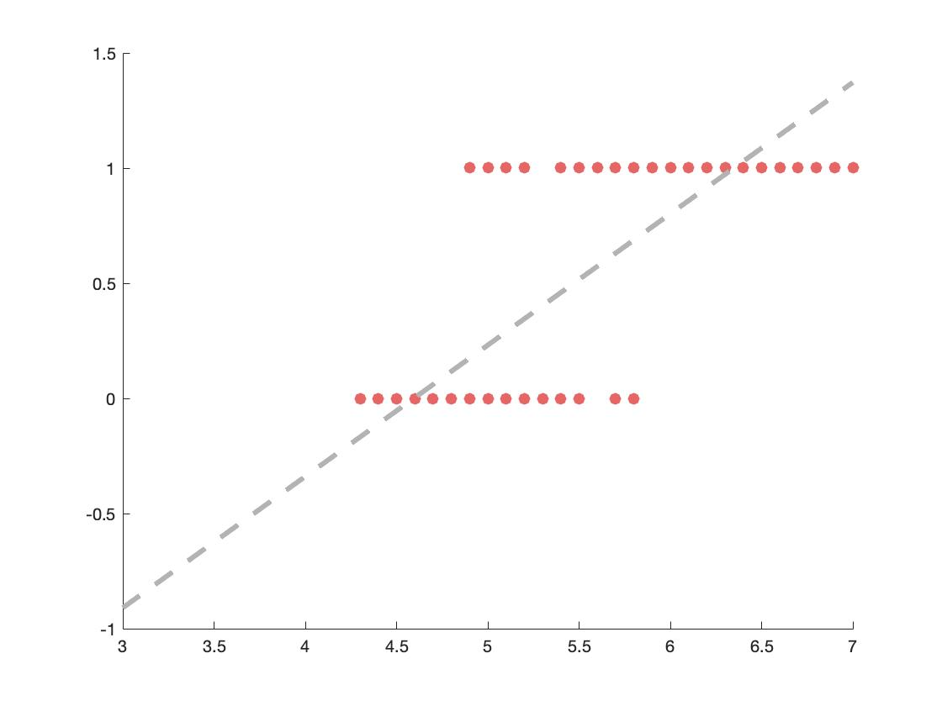
Logistic Regression
Linear regression work very well on continuous outcomes, but what happens when your outcome is categorical or binary? Fitting a line just doesn’t cut it

Slide 35
Logistic Regression
But if we fit a different function to the data, it might fit it much better…
Here comes in Logistic Functions

Slide 36
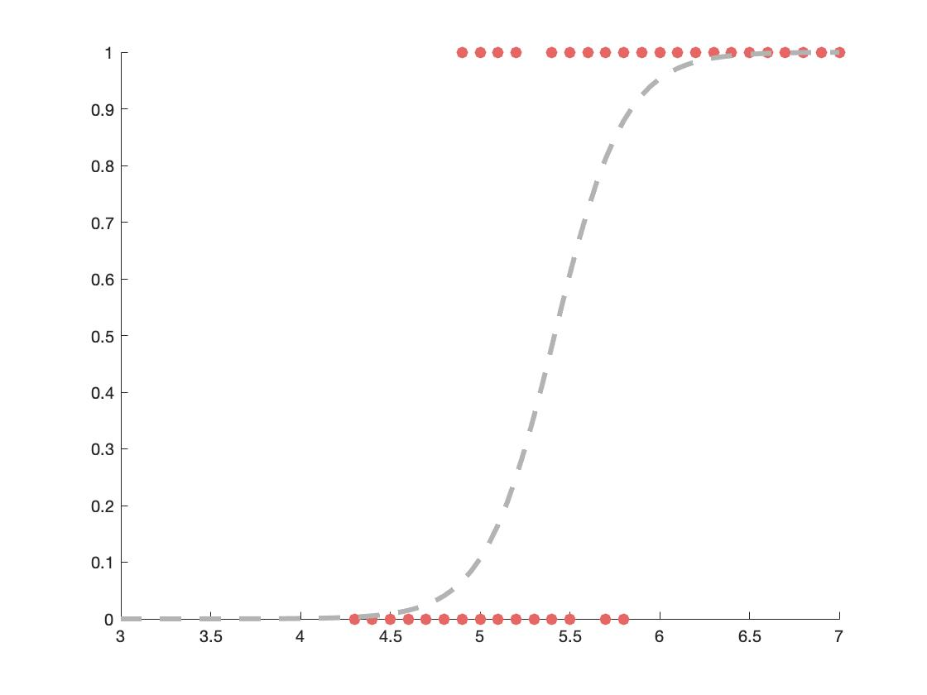
Logistic Regression
But if we fit a different function to the data, it might fit it much better…
Here comes in Logistic Functions

Slide 37
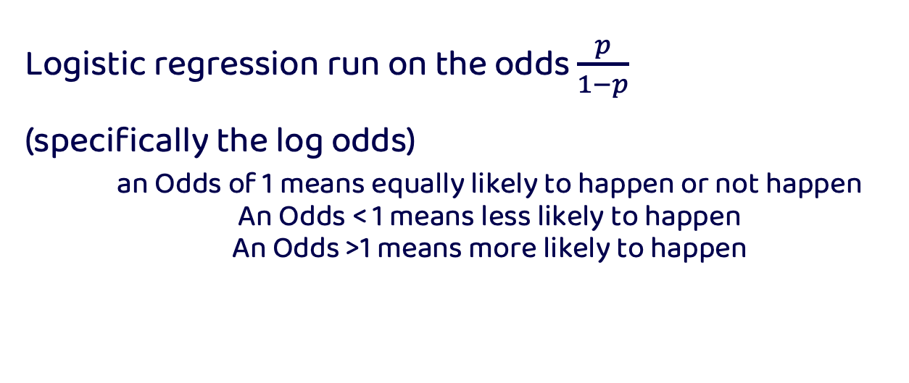
Logistic Regression
Logistic regression run on the odds $\frac{p}{1−p}$
(specifically the log odds)
an Odds of 1 means equally likely to happen or not happen
An Odds < 1 means less likely to happen
An Odds >1 means more likely to happen

Slide 38
Odds
Probability
0 0.5 1
p/(1-p)
Odds
0 1 Inf
ln(x)
Log Odds
-Inf 0 Inf

Slide 39
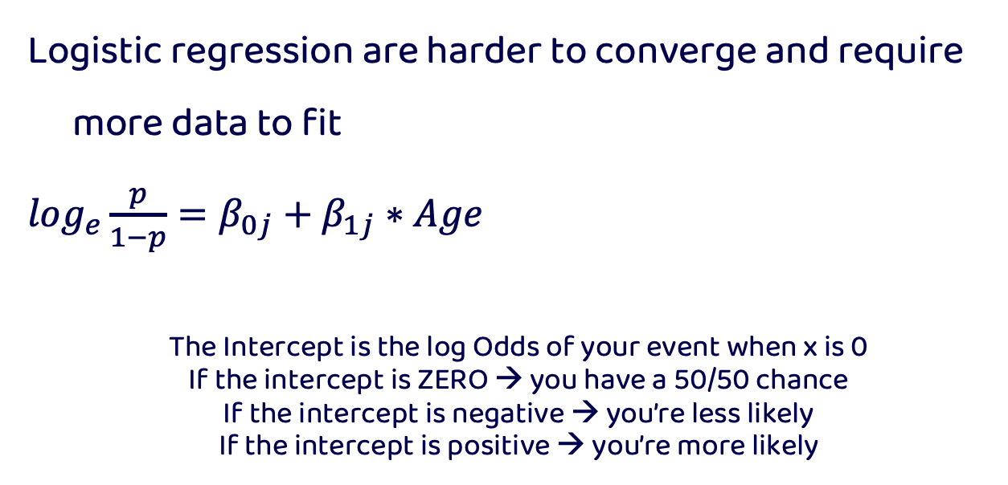
Logistic Regression
Logistic regression are harder to converge and require more data to fit
$\log_{e}\frac{p}{1−p}=β_{0j}+β_{1j}∗Age$
The Intercept is the log Odds of your event when x is 0
If the intercept is ZERO → you have a 50/50 chance
If the intercept is negative → you’re less likely
If the intercept is positive → you’re more likely

Slide 40
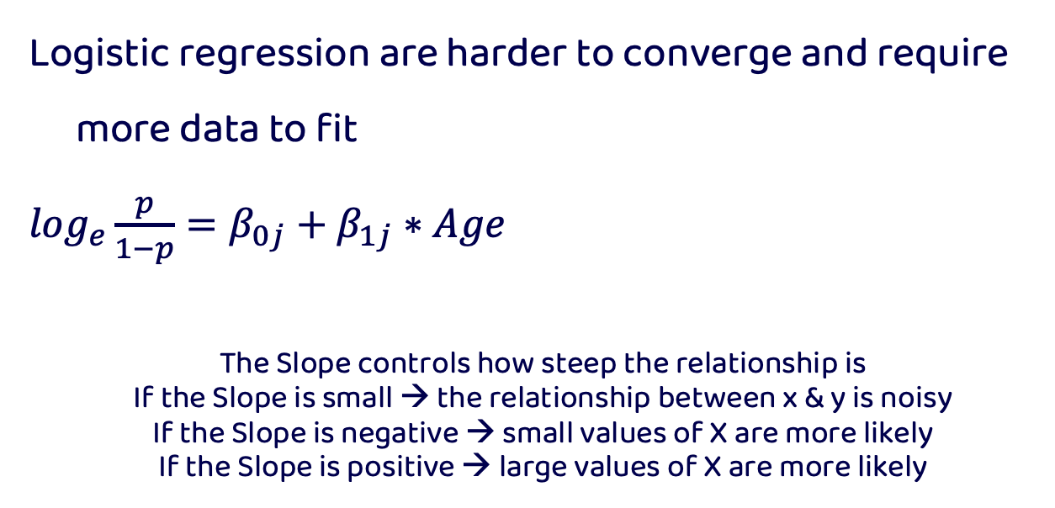
Logistic Regression
Logistic regression are harder to converge and require more data to fit
$\log_{e}\frac{p}{1−p}=β_{0j}+β_{1j}∗Age$
The Slope controls how steep the relationship is
If the Slope is small → the relationship between x & y is noisy
If the Slope is negative → small values of X are more likely
If the Slope is positive → large values of X are more likely

Slide 41


Nested data
What is the best song to dance to?

Slide 42






Nested data
What is the best song to dance to?

Slide 43
Nested data
What is the best song to dance to?
Le Club
Muzique
Le Rouge
GAY
Club MED
Studio 54

Slide 44
Nested data
What is the best song to dance to?
Canada
UK
USA
Le Club
Muzique
Le Rouge
GAY
Club MED
Studio 54

Slide 45
Nested data
Observations within the same country, for example, are more similar to themselves than to a different country
When data is nested, it is important that your model takes into account the correlational structure of your data

Slide 46
Nested data
Regressions assume that all your predictors (i.e., measures) are independent. But this may not always be the case, specifically for repeated measure designs where participants see multiple experimental conditions

Slide 47
Nested data
The independence of each observation is often violated in real life—data is nested in a big wonderful world
People are more similar to themselves, their family, their friends, people from their city, country etc

Slide 48
Nested data
Regression models need to consider the correlated structure of your observations to better deal with noise
Adding this info to your regression will allow you to better predict out of sample

Slide 49
Hierarchical regressions
Hierarchical regressions allow you to take into account the structure of your data to help better estimate your effects and deal with noise that can be accounted for by your nested data

Slide 50
Hierarchical regressions
This is achieved by allowing Intercepts or slopes to vary as a function of the levels/ nests within your data
For example, allowing every person in your sample to get a different intercept accounts for the fact that people have differences in response times, but fixing the slope of the regression lets you test the effect across your conditions

Slide 51
Hierarchical regressions
Fitting a line to our data sometimes does not capture the complicated effect we may have

Slide 52
Hierarchical regressions
Random Intercept
Sometime our effect is constant across individuals, but they may vary in their baseline ability

Slide 53
Hierarchical regressions
Random Slope
Sometime our effect changes across groups too

Slide 54
Hierarchical regressions
See http://mfviz.com/hierarchical-models/ for interactive example demonstrating fixed vs random slopes and intercepts

Slide 55
Fixed vs Random effects
Note that hierarchical models have both fixed and random effects
Fixed effects—assume you have every desired level of variable (e.g., experimental condition)
Random effects—assume you do not have every possible level you wish to test (e.g., participant)

Slide 56
Fixed vs Random effects
Fixed effects—sometimes are also referred to as variables you MANIPULATE
Random effects—sometimes referred to as variables that are sources of variation in your data that you do not care about

Slide 57
Model selection revisited
We can try and quantify a measure that balances both the fit of the model as well as parsimony (i.e., the number of parameters)
Akaike information criterion (AIC).
−2logL(θ) + 2k
Bayesian information criterion (BIC)
−2logL(θ) + k*log(T)
Where k is the number of parameters fit to T observations

Slide 58
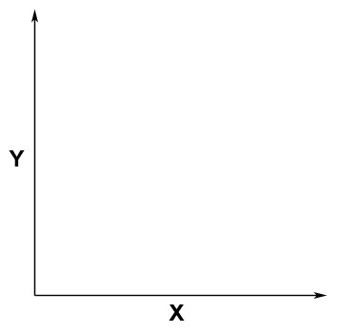
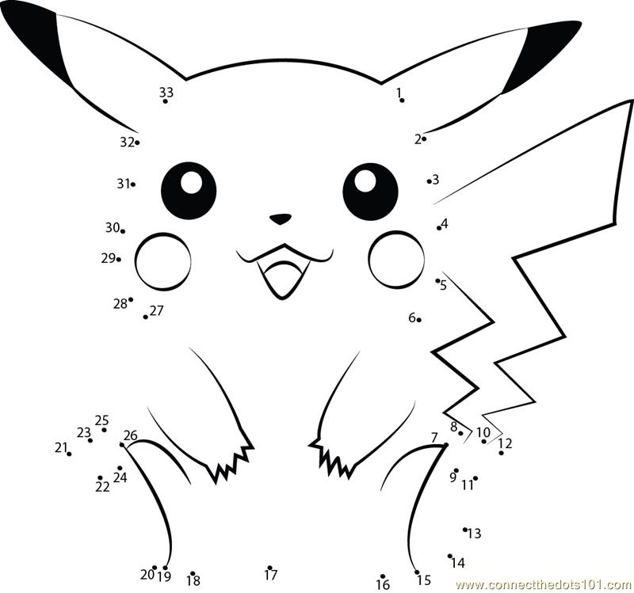
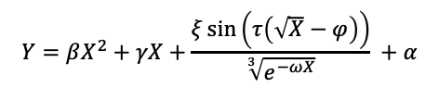
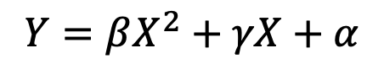
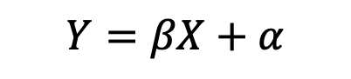
Overfitting
$$Y=βX+α$$
$$Y=βX^{2}+γX+α$$
$$Y=βX^{2}+γX+\frac{ξ\sin\left(τ\left(\sqrt{X}−φ\right)\right)}{\sqrt[3]{e^{−ωX}}} +α$$

Slide 59
Support Vector Machines
Supervised machine learning algorithm that learns to classify two classes of data (can be generalized to multi class problems) given a bunch of examples of each class

Slide 60
Support Vector Machines
It works using support vectors that help create a decision boundary (i.e., a hyperplane) along your multidimensional feature space to classify your inputs.
Support vectors are cases that are very close to the decision boundary (i.e., ambiguous cases)

Slide 61


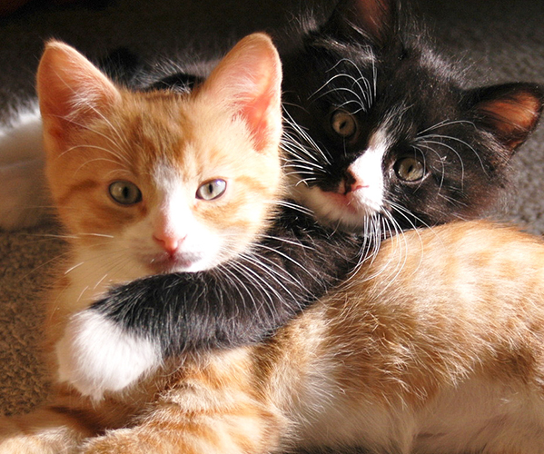

Support Vector Machines

Slide 62



Support Vector Machines

Slide 63
Support Vector Machines

Slide 64
Support Vector Machines

Slide 65
Support Vector Machines

Slide 66
Support Vector Machines

Slide 67
Support Vector Machines
SVM tries to find a hyperplane such that it leaves the widest lane between the edge examples

